Slide 1

Exploratory Data Analysis
ALYA ALMANQOUR

Slide 2

01
DATA DESCRIPTION
QUESTIONS & RESULTS
03
02
04
CONCLUSION
TABLE OF CONTENTS
UNDERSTANDING THE PROBLEM

Slide 3
WORK FLOWE
TRANSFORMATION
Data cleaning
Day 2
Day4
Day 1
Day 3
Day 5
Data Set pick up
Data processing
Results Presentation

Slide 4

An Overview
Dataset Shows Quarterly number of recipients in selected social protection schemes by county in Ireland .

Slide 5
DATA DESCRIPTION
This data was provided by Department of Social Protection of Welfare by virtue of the Central Statistical Office in Ireland .Period of time covered between 2014-01-01and 2021-09-30. Dataset shows 10 columns for 16,736 entries.

Slide 6
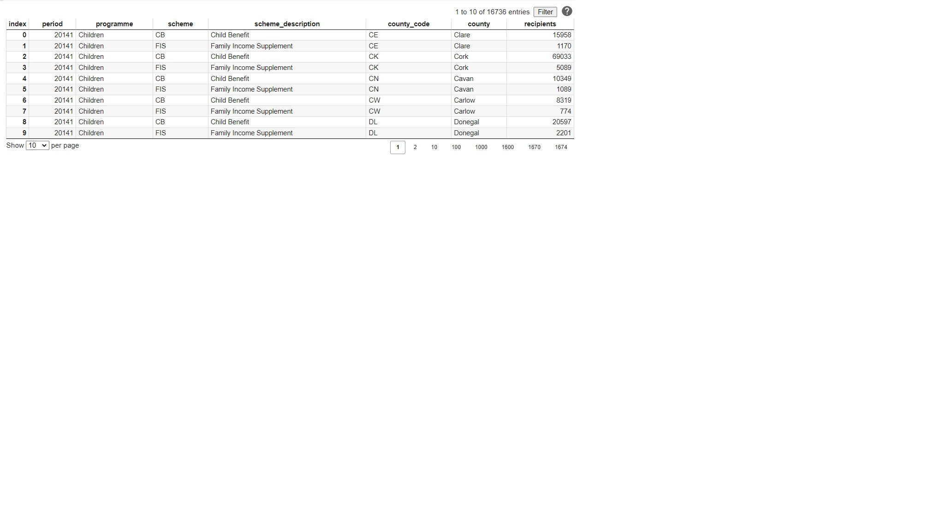
SAMPLE OF DATA
Structure of the data:
id : Unique number to identify each row
period: represents time of year
scheme: Subunit of scheme_ description
scheme_ description: shows the type of benefits
Basis: Subunit of scheme_ description
county code: County name abbreviations
county: county name
recipients: the number of recipients

Slide 7
QUESTIONS
1. Which county have the largest number of recipients?
3. Is the number of recipients increasing or decreasing over the years?
2. What is the most valuable year?
4. Which the most valuable scheme ?

Slide 8
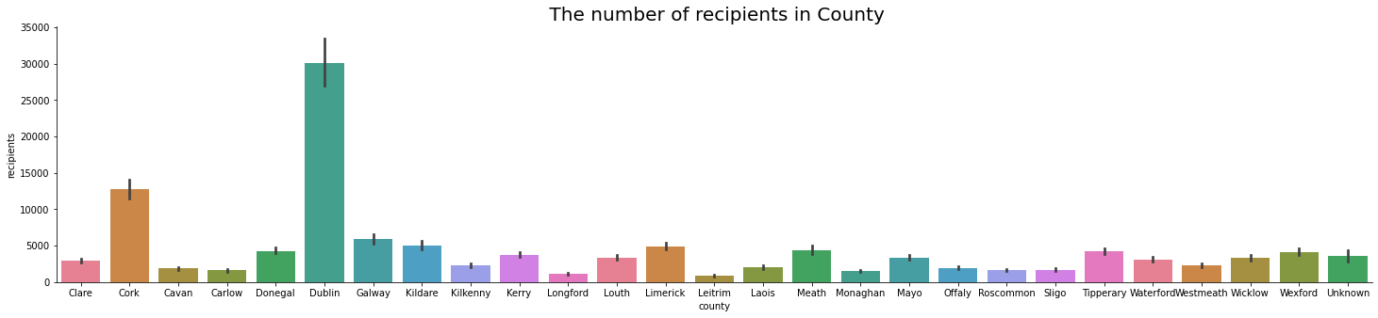
RESULTS

Slide 9
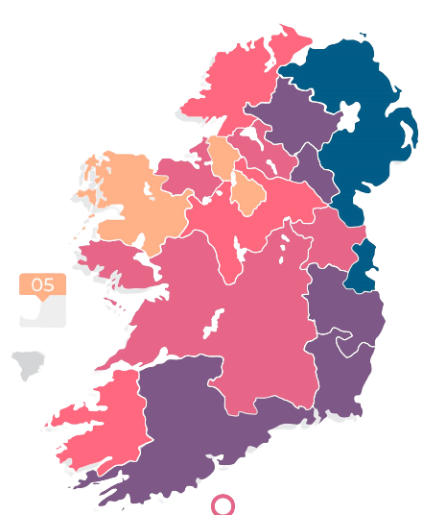
RESULTS
DUBLIN
The largest number by county

Slide 10
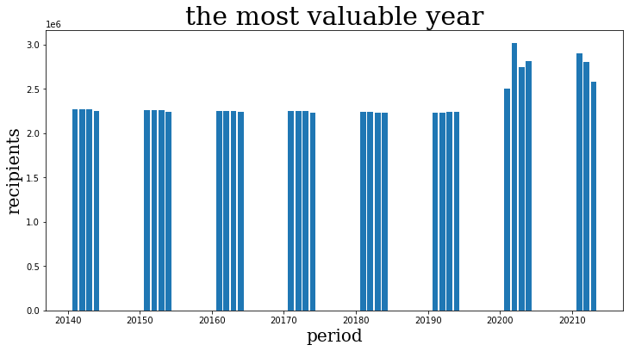
RESULTS

Slide 11
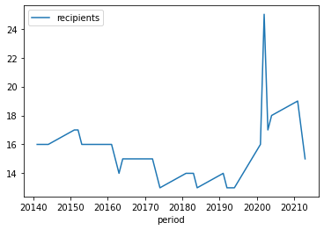
RESULTS

Slide 12
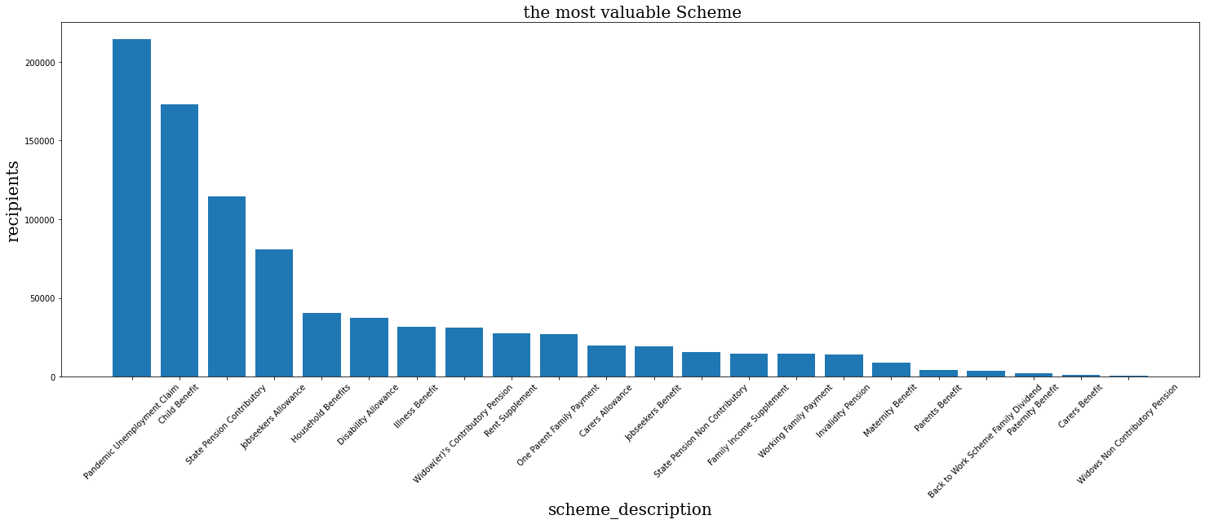
RESULTS

Slide 13
CONCLUSION
EDA is an important step in any Data Analysis or Data Science project
EDA is the process of investigating the dataset to discover patterns, and anomalies (outliers), and form hypotheses based on our understanding of the dataset.

Slide 14
TOOLS
PYTHON , COLABORATORY
MATPLOTLIB
PANDAS, SEABORN

Slide 15

THANKS!
ALYA ALMANQOUR

